Slide 1
DESIGNING EFFECTIVE INPUT AND OUTPUT, AND SYSTEM IMPLEMENTATION

Slide 2
DESIGNING EFFECTIVE INPUT
Making input completion easy and efficient
Assuring input meets the intended purpose
Assuring accurate completion
Making screens and forms attractive
Making input uncomplicated
Creating screens and forms that are consistent

Slide 3
Source Document / Form Design Guidelines
Include instructions for completing the form.
Minimize the amount of handwriting.
Data to be entered (keyed) should be sequenced so that it can be read like a book, that is, top-to-bottom and left-to-right.
When possible, base input design on known metaphors.
Notes:
Chapter 14 - Input Design and Prototyping
No additional notes.

Slide 4
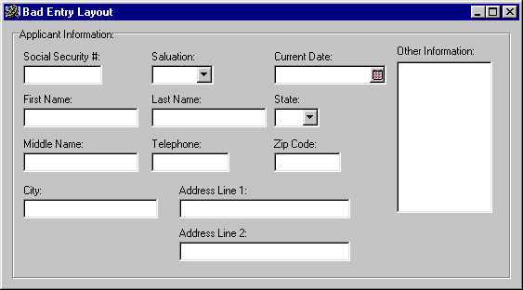
Bad Flow in a Form
Notes:
Chapter 14 - Input Design and Prototyping
No additional notes.

Slide 5
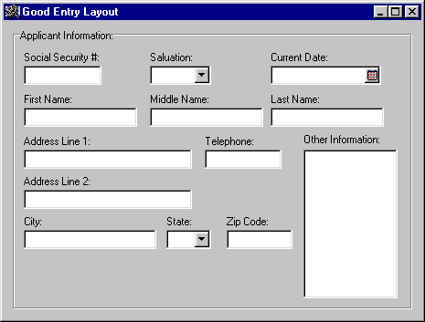
Good Flow in a Form
Notes:
Chapter 14 - Input Design and Prototyping
No additional notes.

Slide 6
GUI Components (or Controls)
Common GUI controls (for both Windows and Web interfaces)
  Text boxes
  Radio buttons
  Check boxes
  List boxes
  Drop down lists
  Combination boxes
  Spin boxes
  Buttons
  Hyperlinks (yes, also for Windows applications—see Quicken 2000)
  Drop down calendars
  etc
Notes:
Chapter 14 - Input Design and Prototyping
No additional notes:

Slide 7
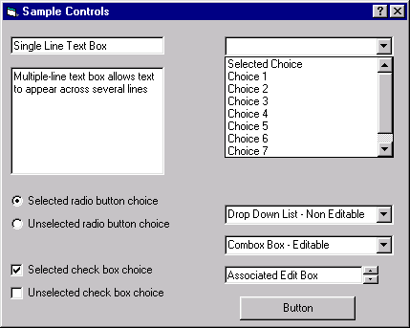
Common GUI Components
Notes:
Chapter 14 - Input Design and Prototyping
No additional notes.

Slide 8
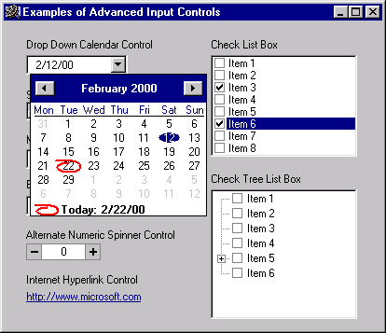
Advanced GUI Components
Notes:
Chapter 14 - Input Design and Prototyping
No additional notes.

Slide 9
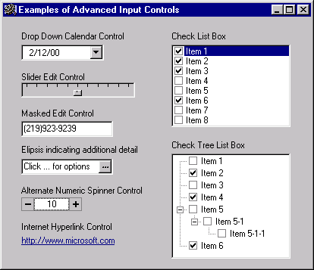
Advanced GUI Components (continued)
Notes:
Chapter 14 - Input Design and Prototyping
No additional notes.

Slide 10
Input Design Process
Identify system inputs and review logical requirements.
Select appropriate input components/controls.
As necessary, design any source documents.
Design, validate and test inputs eg using some Prototyping tools
Notes:
Chapter 14 - Input Design and Prototyping
No additional notes.

Slide 11
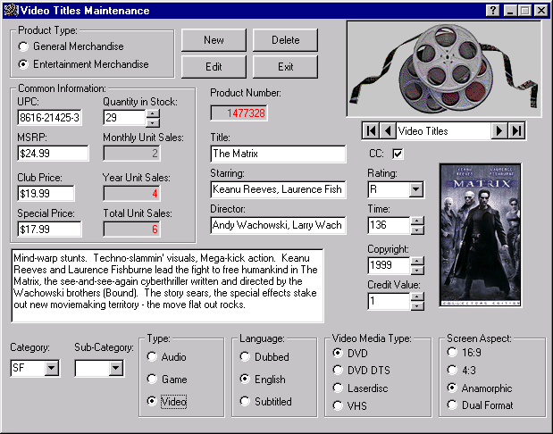
Example Input Prototype for Data Maintenance
Notes:
Chapter 14 - Input Design and Prototyping
No additional notes.

Slide 12
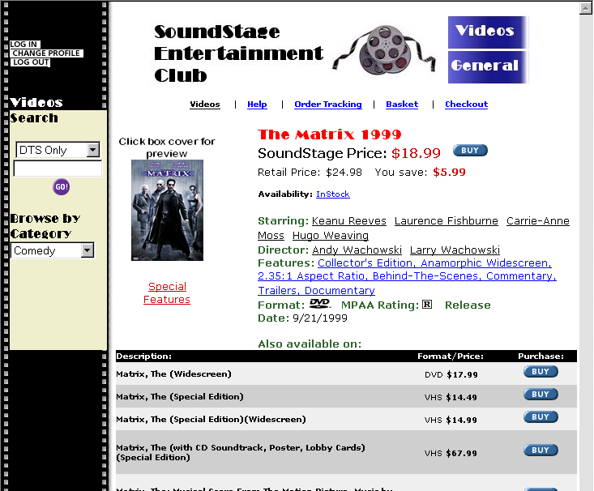
Example Input Prototype for Web Interface
Notes:
Chapter 14 - Input Design and Prototyping
No additional notes.

Slide 13
OUTPUT DESIGN OBJECTIVES
Designing output to serve the intended purpose
Making output meaningful to the user
Delivering the appropriate quantity of output
Making sure the output is where it is needed
Providing the output on time
Choosing the most effective output method

Slide 14
OUTPUT TECHNOLOGIES
Printers
CD ROMs and DVDs
Flash disks
Electronic output – email, faxes, bulletin board messages …
Pull technology
Push technology

Slide 15
FACTORS TO CONSIDER WHEN CHOOSING OUTPUT TECHNOLOGY
Who will use the output
How many people need the output
Where is the output needed
What is the purpose of the output
What is the speed with which output is needed
How frequently will the output be accessed
How long will the output be stored

Slide 16
FACTORS TO CONSIDER WHEN CHOOSING OUTPUT TECHNOLOGY cont
Under what special regulations is the output produced, stored and distributed?
Initial and ongoing costs of maintenance and supplies
Environmental requirements eg space, cabling, noise absorption for output technologies

Slide 17
SUCCESSIVELY IMPLEMENTING THE INFORMATION SYSTEM

Slide 18
TRAINING USERS
Training strategies are determined by who is being trained and who will train them.
Who to train – any one who will have secondary or primary use of the system
Trainers – vendors, system analysts, external paid trainers, inhouse trainers, other system users

Slide 19
GUIDELINES FOR TRAINING
Training objectives – differ depending on who is being trained. Objectives allow evaluation of training when complete.
Training method – determined by kind of job one does, personalities, experience and background.
Training site – can be offsite, onsite
Training materials – training manuals, cases, prototypes and mock-ups of outputs

Slide 20
CONVERSION
Is physically converting the old information system to the new or modified one.
There is no single best way to proceed with conversion

Slide 21
CONVERSION STRATEGIES
DIRECT CHANGEOVER
on a specified date the old system is dropped and the new one put into use. Only successful if extensive testing is done beforehand, and some delays in processing can be tolerated.
Advantage – adaptation is a necessity –no choice between old and new system
Disadvantage – errors lead to long delays, user resistance and no adequate way to compare new results with old

Slide 22
PARALLEL CONVERSION
Old and new system run at the same time, in parallel, for a specified period of time, and reliability of results examined.
Adv – can check new against old data – errors detected. Users not forced to adapt a new system abruptly
Disadv – cost of running the two systems in parallel, doubling employees workload, employees may not be very enthusiastic about using the new system

Slide 23
GRADUAL / PHASED CONVERSION
The volume of transactions handled by the new system is gradually increased as the system is phased in.
Adv – detecting and recovering from errors without lots of downtime, user acceptance higher
Disadv – taking long to get the new system in place, inappropriate for small, uncomplicated systems

Slide 24
MODULAR PROTOTYPE CONVERSION
Building of modular operational prototypes in a gradual manner
Adv – each module is thoroughly tested before being used, users familiar with each module before it becomes operational
Disadv- special attention needed for interfaces, and prototyping not usually feasible

Slide 25
DISTRIBUTED CONVERSION
Many installations of the same system are contemplated eg in banking, restaurants
One entire conversion is done using the above approaches at one site, and if succesful done for other sites
Adv – problems can be detected and contained rather than inflicted simultaneously on all sites
Disadv – each site has its own peculiarities which should be handled accordingly.

Slide 26
Note
No particular conversion approach is equally suitable for every system implementation.
A contingency approach on deciding on a conversion strategy is recommended

Slide 27
SECURITY CONCERNS FOR TRADITIONAL AND WEB-BASED SYSTEMS
Security of computer facilities, stored data and the information generated is part of a successful conversion.
Security can be
Physical
Logical
Behavioural

Slide 28
Physical security
Securing computer facility, its equipment and software through physical means –
machine readable badges,
human sign in/out system,
closed circuit television cameras,
regular back up in fireproof, waterproof areas etc

Slide 29
Logical security
Refers to logical controls within software itself. Includes
passwords and authorization codes,
encryption,
firewalls

Slide 30
Behavioural security
Screening of employees
Clear policies regarding security
Monitoring behaviours at irregular intervals
Logging
Periodic and frequent inventorying of equipment and software
Examine unusually long sessions or a typical after-hours access to the system

Slide 31
EVALUATION
THE INFORMATION SYSTEM UTILITY APPROACH – used to measure the success of a developed system.

Slide 32
UTILITIES OF INFORMATION
Possession utility – who should receive output
Form utility – what kind of output is distributed to the decision maker
Place utility – where is the information distributed
Time utility – when is the information delivered

Slide 33
UTILITIES OF INFORMATION
Actualization utility – how is the information introduced and used by the decision maker
Goal utility –whether the output has value in helping the organization obtain its objectives

Slide 34
EVALUATING THE SYSTEM
An IS can be evaluated as successful if it possesses all the six utilities.
Failure – module judged as poor in providing one of the utilities
Partially successful- fair attainment of a utility
Successful – module good in providing every utility

Slide 35
Summary
Implementation is the process of ensuring that information systems and networks are operational and then involving well trained users in their operation.
Analyst needs oversee implementation:
correctly estimate the time needed,
supervise installation of equipment,
training users,
converting files and databases to the new system

Slide 36
Class Task
Differentiate between:
Unit testing
Integration testing
Acceptance testing

